Slide 1
Chapter 7
Memory and Programmable Logic

Slide 2
7-1. Introduction
A memory unit is a device to which binary information is transferred for storage and from which information is retrieved when needed for processing.
Binary information received from an input device is stored in memory, and information transferred to an output device is taken from memory.
A memory unit is a collection of cells capable of storing a large quantity of binary information.

Slide 3
7-1. Introduction
There are two types of memories that are used in digital systems:
Random-access memory(RAM): perform both the write and read operations.
Read-only memory(ROM): perform only the read operation.
The read-only memory is a programmable logic device. Other such units are the programmable logic array(PLA), the programmable array logic(PAL), and the field-programmable gate array(FPGA).

Slide 4
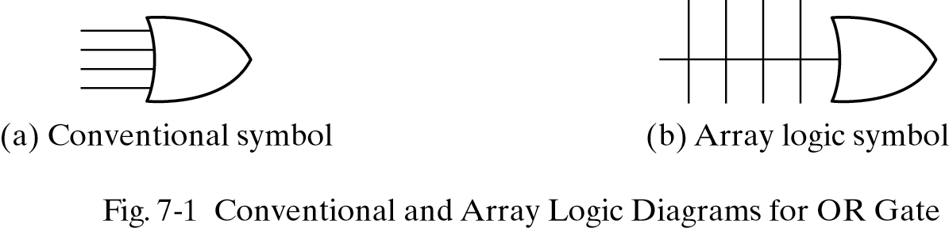
Array logic
A typical programmable logic device may have hundreds to millions of gates interconnected through hundreds to thousands of internal paths.
In order to show the internal logic diagram in a concise form, it is necessary to employ a special gate symbology applicable to array logic.

Slide 5
7-2. Random-Access Memory
A memory unit is a collection of storage cells, together with associated circuits needed to transfer information into and out of a device.
The time it takes to transfer information to or from any desired random location is always the same—hence the name random‐access memory, abbreviated RAM.
In contrast, the time required to retrieve information that is stored on magnetic tape depends on the location of the data.

Slide 6
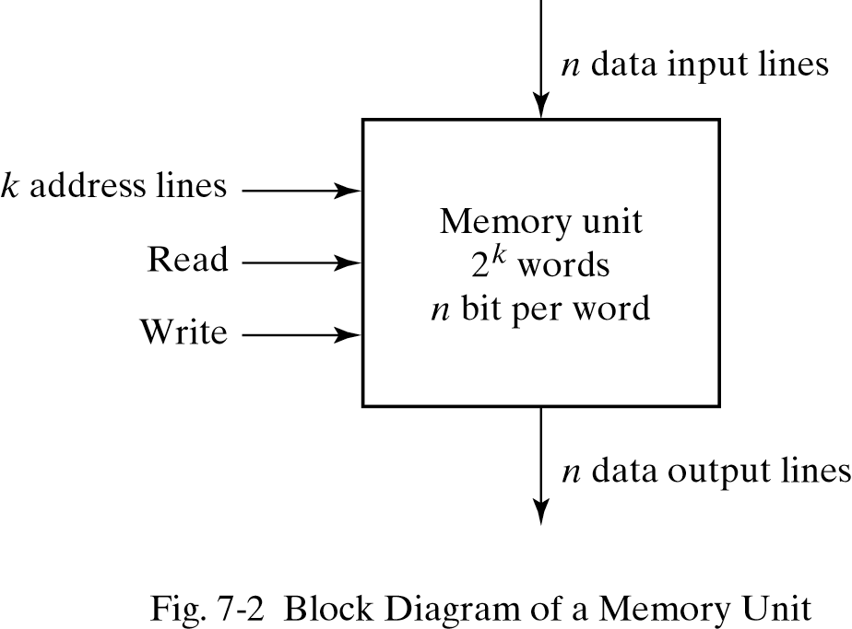
7-2. Random-Access Memory
A memory unit stores binary information in groups of bits called words.
1 byte = 8 bits
1 word = 2 bytes
The communication between a memory and its environment is achieved through data input and output lines, address selection lines, and control lines that specify the direction of transfer.

Slide 7
7-2. Random-Access Memory
n data input lines ---> provide the information to be stored in memory
n data output lines ---> supply theinformation coming out of memory.
The k address lines ---> specify the particular word chosen among the many available.
The two control inputs ---> specify the direction of transfer desired
The Write input ---> causes binary data to be transferred into the memory, and
The Read input ---> causes binary data to be transferred out of memory.

Slide 8
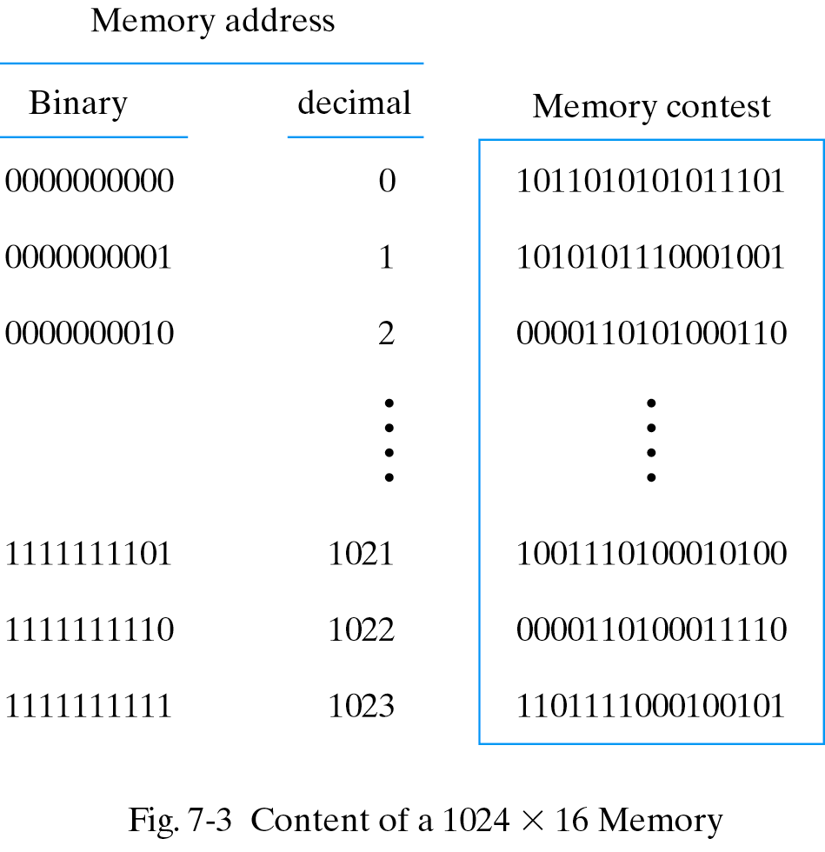
Content of a memory
Each word in memory is assigned an identification number, called an address, starting from 0 up to 2^{k}-1, where k is the number of address lines.
The number of words in a memory with one of the letters K=2¹⁰, M=2²⁰, or G=2³⁰.
64K = 2¹⁶ 2M = 2²¹
4G = 2³²

Slide 9
Write and Read operations
Transferring a new word to be stored into memory:
Apply the binary address of the desired word to the address lines.
Apply the data bits that must be stored in memory to the data input lines.
Activate the write input.

Slide 10
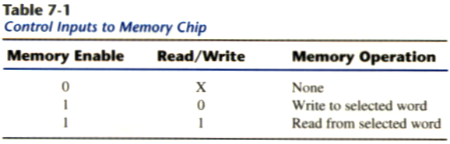
Write and Read operations
Transferring a stored word out of memory:
Apply the binary address of the desired word to the address lines.
Activate the read input.
Commercial memory sometimes provide the two control inputs for reading and writing in a somewhat different configuration in table 7-1.

Slide 11
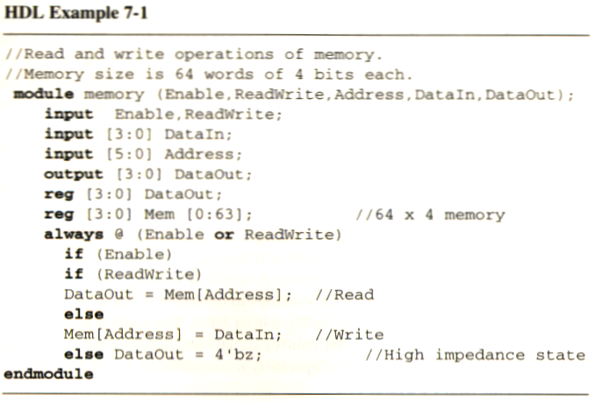
Memory description in HDL
A memory of 1024 words with 16-bits per word is declared as
reg [15:0] memword[0:1023];
Read/Write = 1
DataOut ← Mem[Address];
Read/Write =0
Mem[Address] ← DataIn;

Slide 12
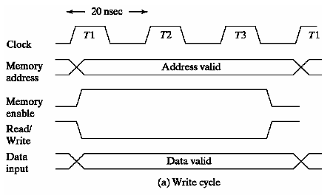
Timing Waveforms (write)
The access time and cycle time of the memory must be within a time equal to a fixed number of CPU clock cycles.
The memory enable and the read/write signals must be activated after the signals in the address lines are stable to avoid destroying data in other memory words.
Enable and read/write signals must stay active for at least 50ns.

Slide 13
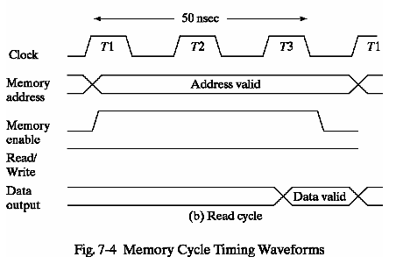
Timing Waveforms (read)
The CPU can transfer the data into one of its internal registers during the negative transition of T3.

Slide 14
Types of memories
In random-access memory, the word locations may be thought of as being separated in space, with each word occupying one particular location.
In sequential-access memory, the information stored in some medium is not immediately accessible, but is available only certain intervals of time. A magnetic disk or tape unit is of this type.

Slide 15
Types of memories
In a random-access memory, the access time is always the same regardless of the particular location of the word.
In a sequential-access memory, the time it takes to access a word depends on the position of the word with respect to the reading head position; therefore, the access time is variable.

Slide 16
Static RAM
SRAM consists essentially of internal latches that store the binary information.
The stored information remains valid as long as power is applied to the unit.
SRAM is easier to use and has shorter read and write cycles.
Low density, low capacity, high cost, high speed, high power consumption.

Slide 17
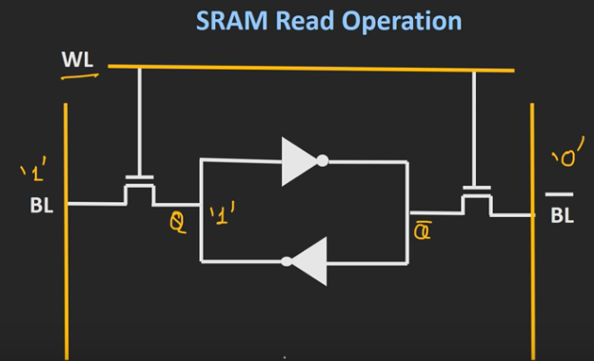
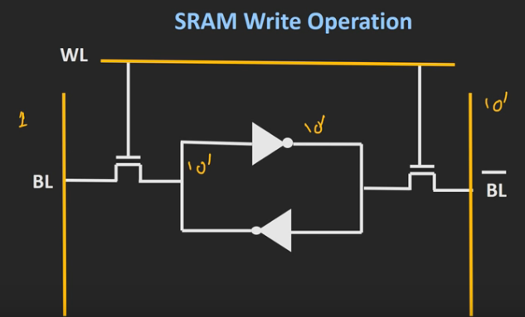
Static RAM

Slide 18
Dynamic RAM
DRAM stores the binary information in the form of electric charges on capacitors.
The capacitors are provided inside the chip by MOS transistors.
The capacitors tends to discharge with time and must be periodically recharged by refreshing the dynamic memory.

Slide 19
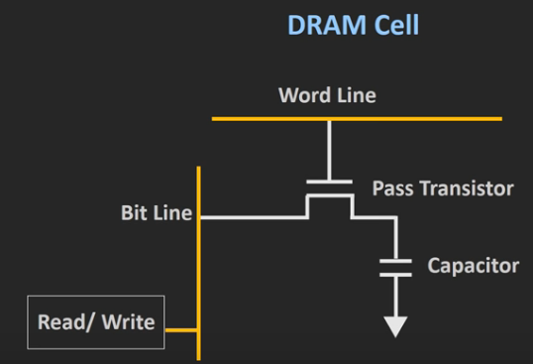
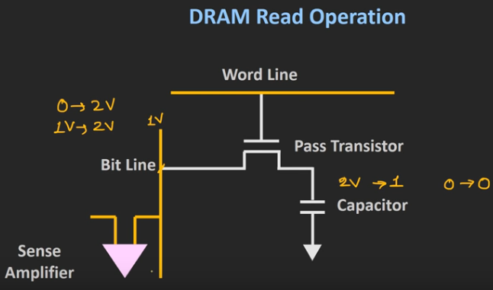
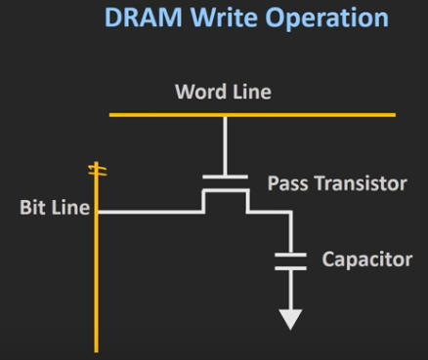
Dynamic RAM

Slide 20
Dynamic RAM
DRAM offers reduced power consumption and larger storage capacity in a single memory chip.
High density, high capacity, low cost, low speed, low power consumption.

Slide 21
Types of memories
Memory units that lose stored information when power is turned off are said to be volatile.
Both static and dynamic, are of this category since the binary cells need external power to maintain the stored information.
Nonvolatile memory, such as magnetic disk, ROM, retains its stored information after removal of power.

Slide 22
7-4. Error detection and correction
It is protecting the occasional errors in storing and retrieving the binary information.
Parity can be checked the error, but it can’t be corrected.
An error-correcting code generates multiple parity check bits that are stored with the data word in memory.

Slide 23
Hamming Code
One of the most common used in RAM was devised by R. W. Hamming (called Hamming code).
In Hamming code:
k = parity bits in n-bit data word,
forming a new word of n + k bits. Those positions numbered as a power of 2 are reserved for the parity bits.
the remaining bits are the data bits.

Slide 24
Hamming Code
Ex. Consider the 8-bit data word 11000100. we include four parity bits with it and arrange the 12 bits as follows:
Bit position: 1 2 3 4 5 6 7 8 9 10 11 12
P₁ P₂ 1 P₄ 1 0 0 P₈ 0 1 0 0
P₁ = XOR of bits(3,5,7,9,11) = 1 ⊕ 1 ⊕ 0 ⊕ 0 ⊕ 0 = 0
P₂ = XOR of bits(3,6,7,10,11) = 1 ⊕ 0 ⊕ 0 ⊕ 1 ⊕ 0 = 0
P₄ = XOR of bits(5,6,7,12) = 1 ⊕ 0 ⊕ 0 ⊕ 0 = 1
P₈ = XOR of bits(9,10,11,12) = 0 ⊕ 1 ⊕ 0 ⊕ 0 = 1

Slide 25
Hamming Code
The data is stored in memory together with the parity bit as 12-bit composite word.
Bit position: 1 2 3 4 5 6 7 8 9 10 11 12
0 0 1 1 1 0 0 1 0 1 0 0
When read from memory, the parity is checked over the same combination of bits including the parity bit.
C₁ = XOR of bits(3,5,7,9,11)
C₂ = XOR of bits(3,6,7,10,11)
C₄ = XOR of bits(5,6,7,12)
C₈ = XOR of bits(9,10,11,12)

Slide 26
Error-Detection
A 0 check bit designates an even parity over the checked bits and a 1 designates an odd parity.
Since the bits were stored with even parity, the result,
C = C₈C₄C₂C₁ = 0000, indicates that no error has occurred.
If C ≠ 0, then the 4-bit binary number formed by the check bits gives the position of the erroneous bit.

Slide 27
Example
Bit position: 1 2 3 4 5 6 7 8 9 10 11 12
0 0 1 1 1 0 0 1 0 1 0 0 No error
1 0 1 1 1 0 0 1 0 1 0 0 Error in bit 1
0 0 1 1 0 0 0 1 0 1 0 0 Error in bit 5
Evaluating the XOR of the corresponding bits, get the four check bits
C₈ C₄ C₂ C₁
_{For no error: 0 0 0 0}
with error in bit 1: 0 0 0 1
with error in bit 5: 0 1 0 1

Slide 28
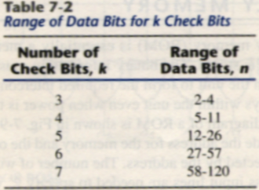
Hamming Code
The Hamming Code can be used for data words of any length.
Total bit in Hamming Code is n + k bits, the syndrome value C consists of k bits and has a range of 2^{k} value between 0 and 2^{k} − 1. the range of k must be equal to or greater than n + k, giving the relationship
2^{k}-1 ≥ n + k

Slide 29
Single-Error correction, Double-Error detection
The Hamming Code can detect and correct only a single error.
By adding another parity bit to the coded word, the Hamming Code can be used to correct a single error and detect double errors. Becomes 001110010100P₁₃.
001110010100 P₁₃ → 001110010100 1
P= XOR( 001110010100 1 )
if P = 0, the parity is correct (even parity), but if P = 1, then the parity over the 13 bits is incorrect (odd parity).
the following four cases can occur:

Slide 30
Single-Error correction, Double-Error detection
If C = 0 and P = 0, no error occurred
If C ≠ 0 and P = 1, a single error occurred that can be corrected
If C ≠ 0 and P = 0, a double error occurred that is detected but that cannot be corrected
If C = 0 and P = 1, an error occurred in the P₁₃ bit

Slide 31
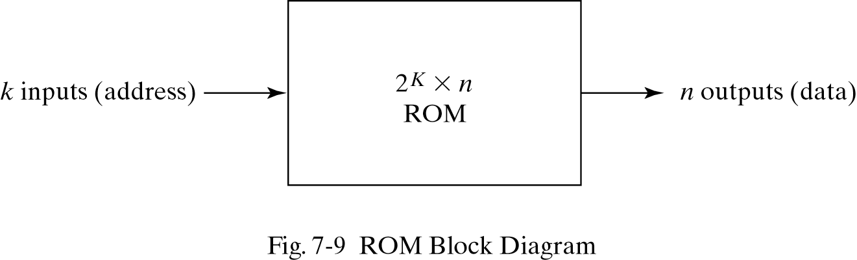
7-5. Read-Only Memory
A block diagram of a ROM is shown below. It consists of k address inputs and n data outputs.
The number of words in a ROM is determined from the fact that k address input lines are needed to specify 2^{k} words.

Slide 32
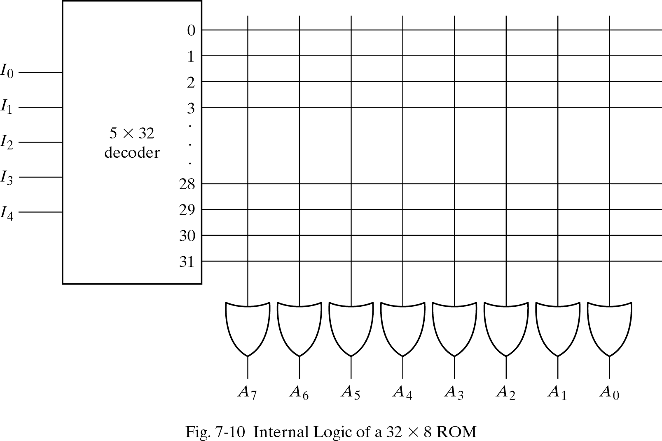
Construction of ROM
Each output of the decoder represents a memory address.
Each OR gate must be considered as having 32 inputs.
A 2^{k} X n ROM will have an internal k X 2^{k} decoder and n OR gates.

Slide 33
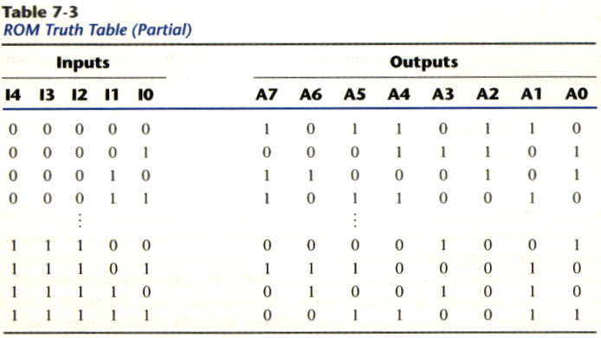
Truth table of ROM
A programmable connection between to lines is logically equivalent to a switch that can be altered to either be close or open.
Intersection between two lines is sometimes called a cross-point.

Slide 34
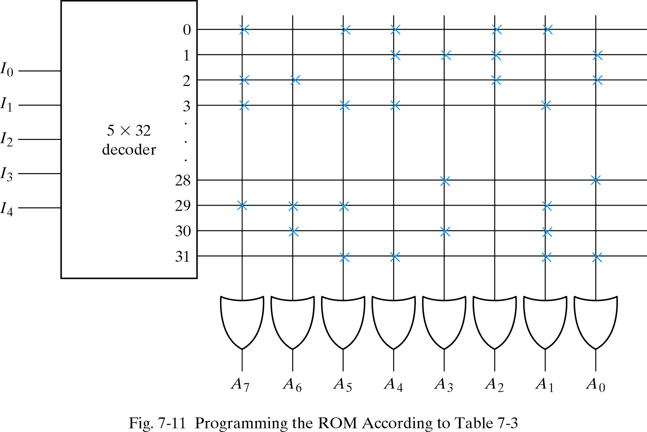
Programming the ROM
In Table 7-3, 0 → no connection
1 → connection
Address 3 = 10110010 is permanent storage using fuse link
1 0 1 1 0 0 1 0
X : means connection

Slide 35
Combinational circuit implementation
The internal operation of a ROM can be interpreted in two way: First, a memory unit that contains a fixed pattern of stored words. Second, implements a combinational circuit.
Fig. 7-11 may be considered as a combinational circuit with eight outputs, each being a function of the five input variables.
A₇(I₄, I₃, I₂, I₁, I₀) = Σ(0,2,3…,29)
Sum of minterms
In Table 7-3, output A₇

Slide 36
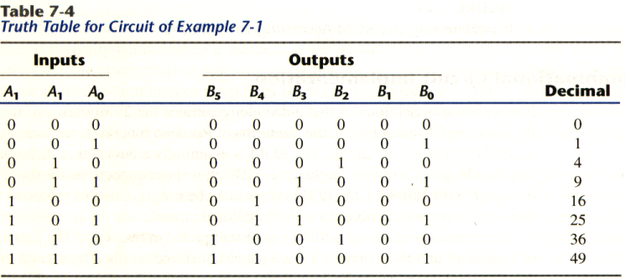
Example
Design a combinational circuit using a ROM. The circuit accepts a 3-bit number and generates an output binary number equal to the square of the input number.
Derive truth table first

Slide 37
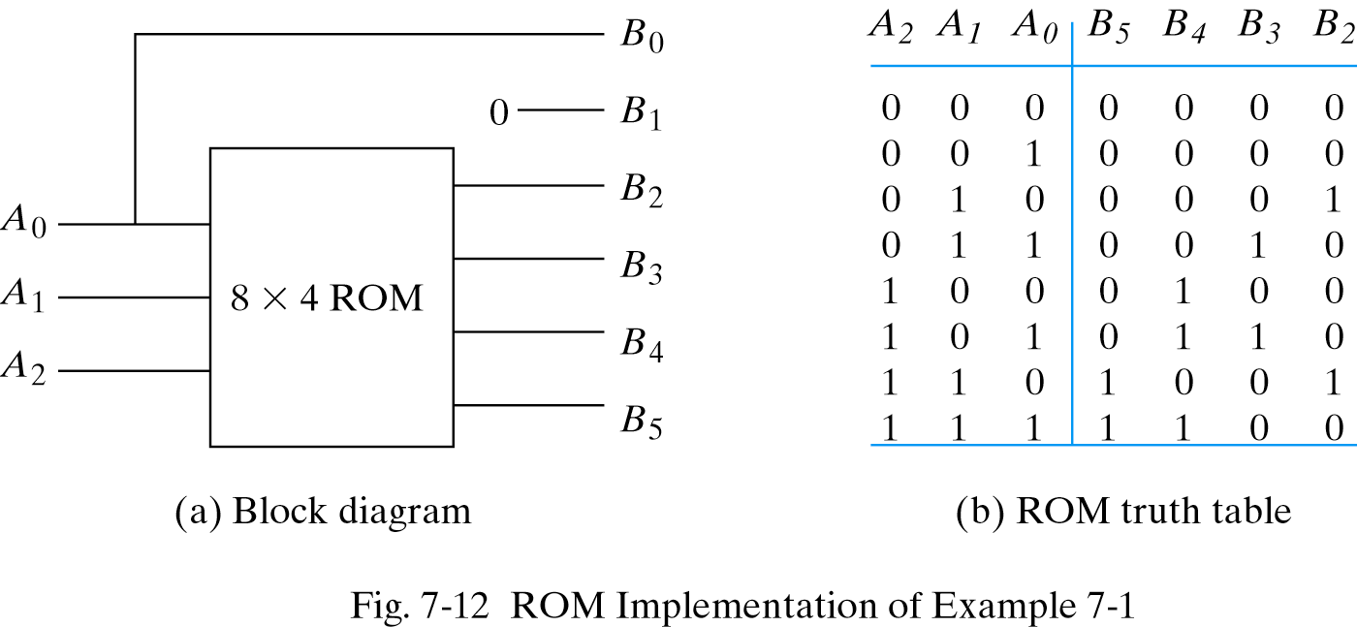
Example

Slide 38
Types of ROMs
The required paths in a ROM may be programmed in four different ways.
Mask programming: fabrication process
Read-only memory or PROM: blown fuse /fuse intact
Erasable PROM or EPROM: placed under a special ultraviolet light for a given period of time will erase the pattern in ROM.
Electrically-erasable PROM(EEPROM): erased with an electrical signal instead of ultraviolet light.

Slide 39
Combinational PLDs
A combinational PLD is an integrated circuit with programmable gates divided into an AND array and an OR array to provide an AND-OR sum of product implementation.
PROM: fixed AND array constructed as a decoder and programmable OR array.
PAL: programmable AND array and fixed OR array.
PLA: both the AND and OR arrays can be programmed.

Slide 40
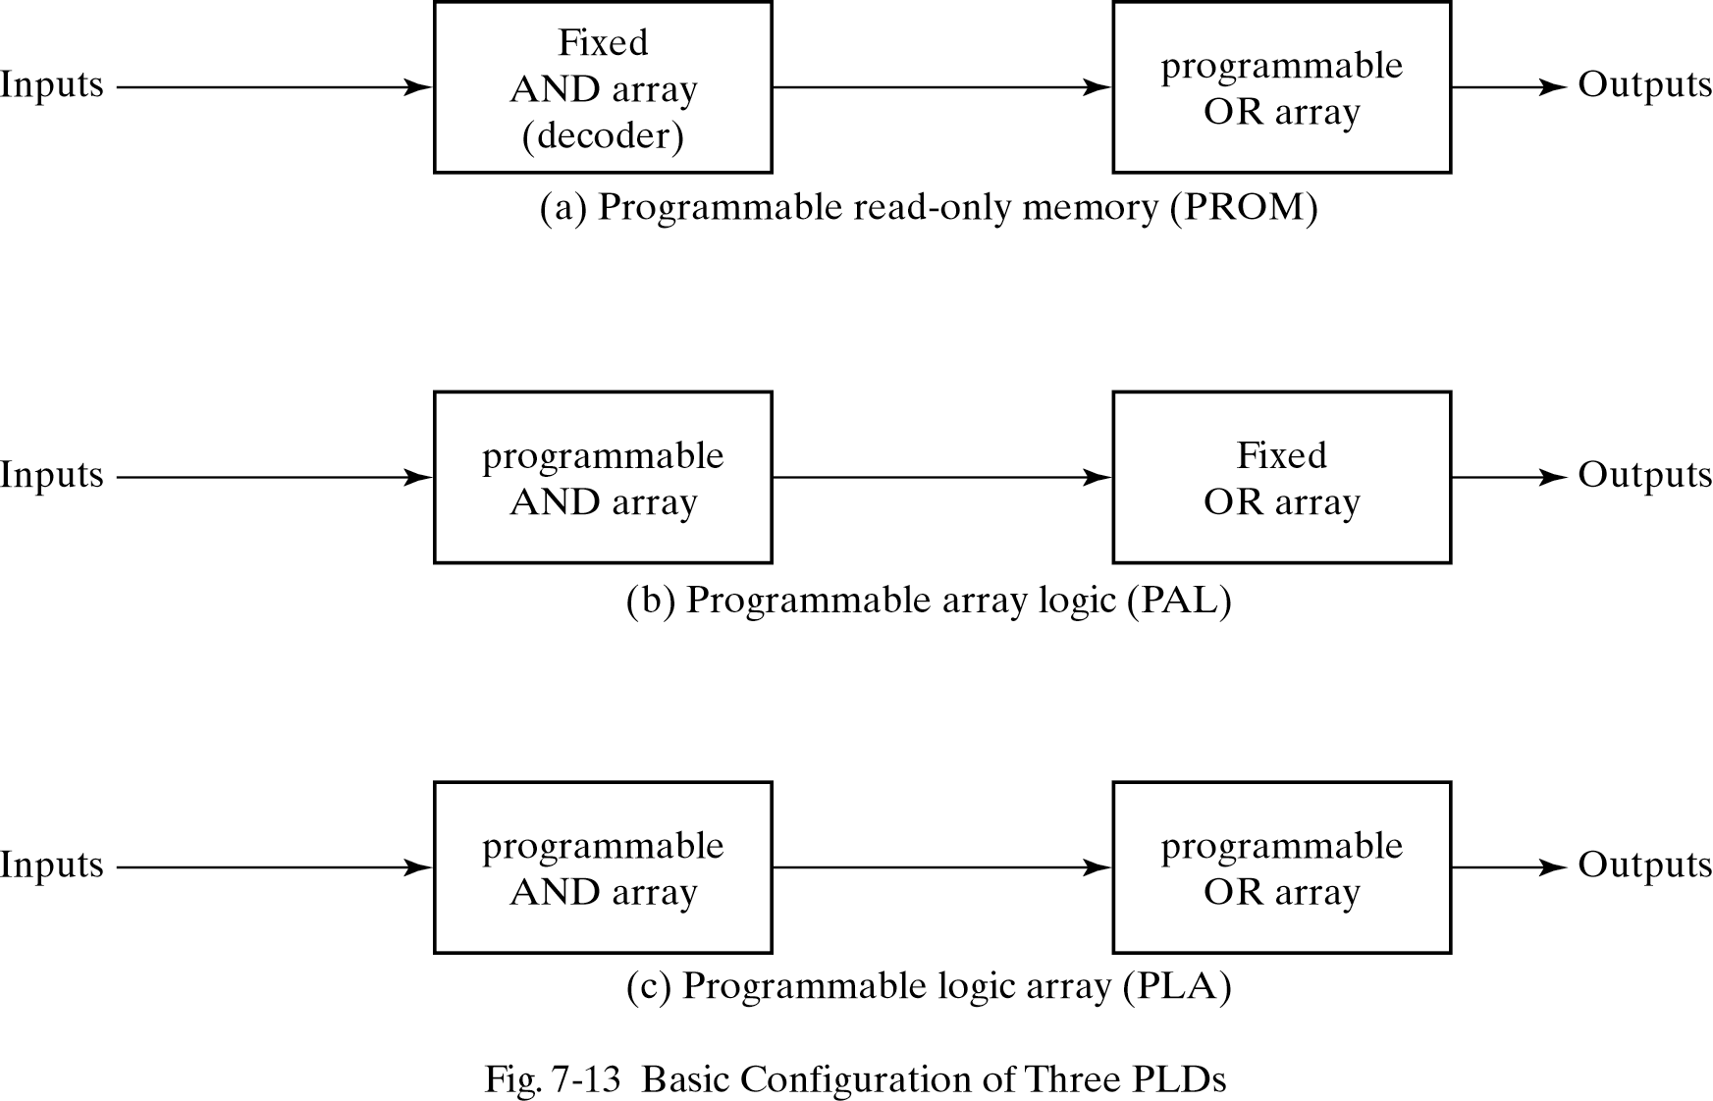
Combinational PLDs

Slide 41
7-6. Programmable Logic Array
Fig.7-14, the decoder in PROM is replaced by an array of AND gates that can be programmed to generate any product term of the input variables.
The product terms are then connected to OR gates to provide the sum of products for the required Boolean functions.
The output is inverted when the XOR input is connected to 1 (since x⊕1 = x’). The output doesn’t change and connect to 0 (since x⊕0 = x).

Slide 42
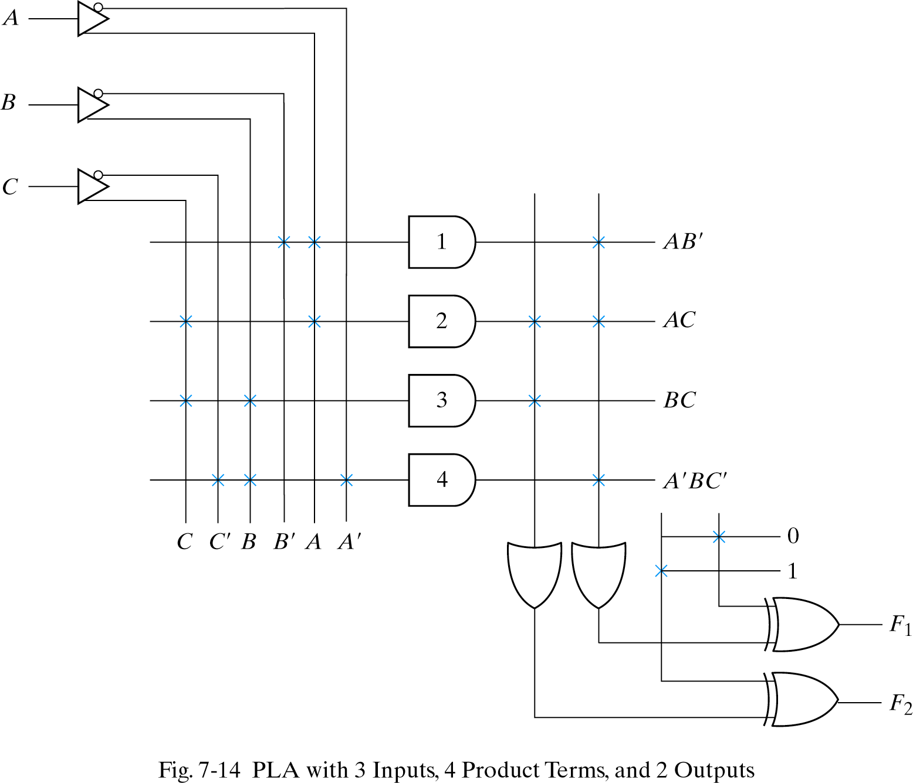
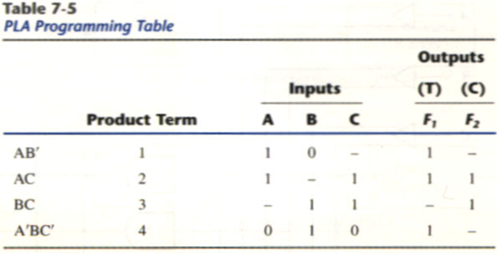
PLA
F1 = AB’+AC+A’BC’
F2 = (AC+BC)’

Slide 43
Programming Table
First: lists the product terms numerically
Second: specifies the required paths between inputs and AND gates
Third: specifies the paths between the AND and OR gates
For each output variable, we may have a T(ture) or C(complement) for programming the XOR gate

Slide 44
Simplification of PLA
Careful investigation must be undertaken in order to reduce the number of distinct product terms, PLA has a finite number of AND gates.
Both the true and complement of each function should be simplified to see which one can be expressed with fewer product terms and which one provides product terms that are common to other functions.

Slide 45
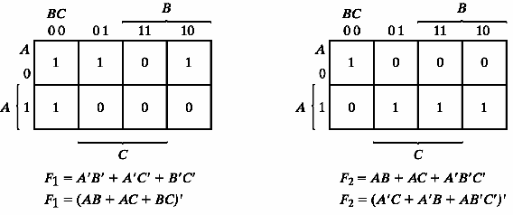
Example 7-2
Implement the following two Boolean functions with a PLA:
F₁(A, B, C) = ∑(0, 1, 2, 4)
F₂(A, B, C) = ∑(0, 5, 6, 7)
The two functions are simplified in the maps of Fig.7-15
1 elements
0 elements

Slide 46
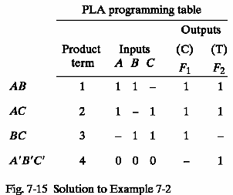
PLA table by simplifying the function
Both the true and complement of the functions are simplified in sum of products.
We can find the same terms from the group terms of the functions of F₁, F₁’,F₂ and F₂’ which will make the minimum terms.
F1 = (AB + AC + BC)’
F2 = AB + AC + A’B’C’

Slide 47
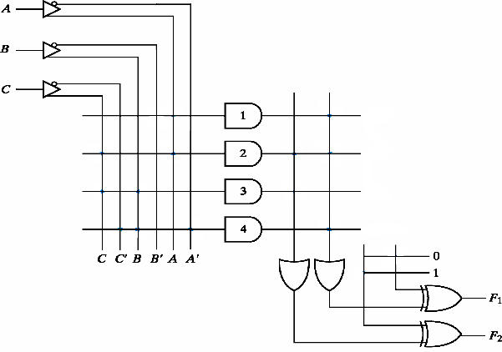
PLA implementation
AB
AC
BC
A’B’C’

Slide 48
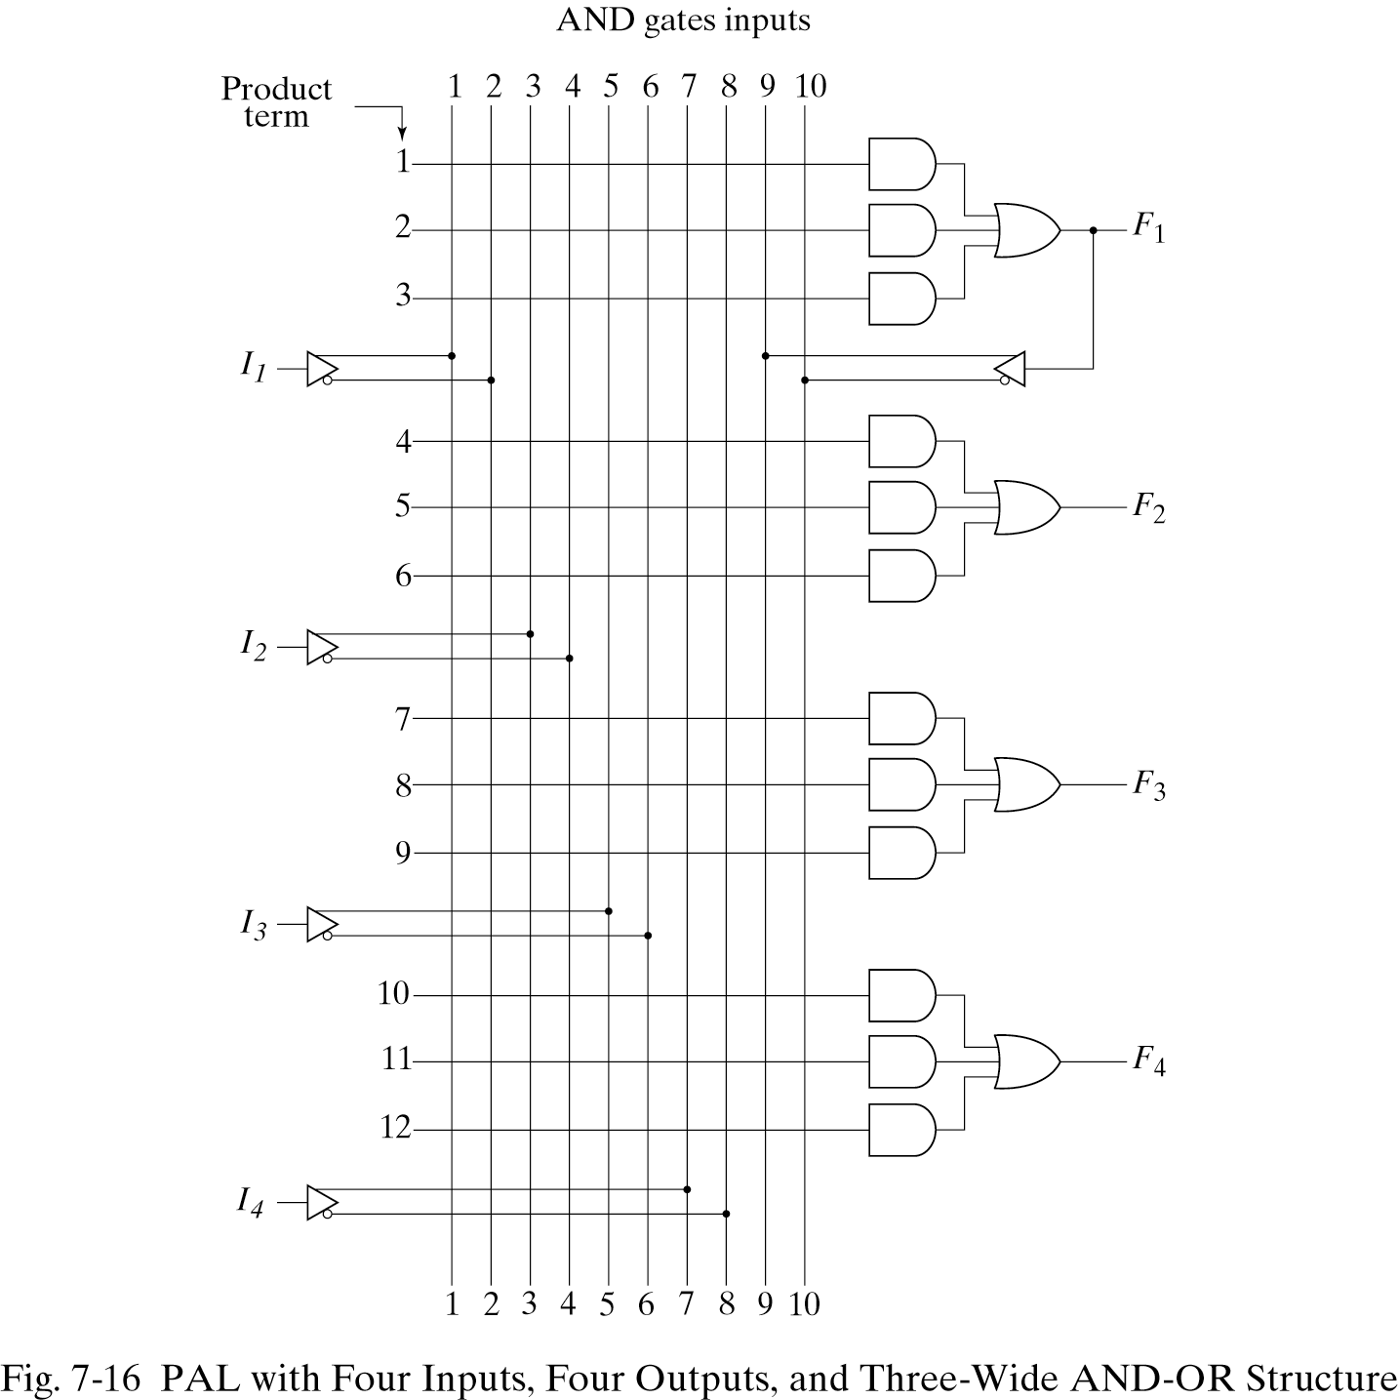
7-7. Programmable Array Logic
The PAL is a programmable logic device with a fixed OR array and a programmable AND array.

Slide 49
PAL
When designing with a PAL, the Boolean functions must be simplified to fit into each section.
Unlike the PLA, a product term cannot be shared among two or more OR gates. Therefore, each function can be simplified by itself without regard to common product terms.
The output terminals are sometimes driven by three-state buffers or inverters.

Slide 50
Example
w(A, B, C, D) = ∑(2, 12, 13)
x(A, B, C, D) = ∑(7, 8, 9, 10, 11, 12, 13, 14, 15)
y(A, B, C, D) = ∑(0, 2, 3, 4, 5, 6, 7, 8, 10, 11, 15)
z(A, B, C, D) = ∑(1, 2, 8, 12, 13)
Simplifying the four functions as following Boolean functions:
w = ABC’ + A’B’CD’
x = A + BCD
w = A’B + CD + B’D’
w = ABC’ + A’B’CD’ + AC’D’ + A’B’C’D = w + AC’D’ + A’B’C’D

Slide 51
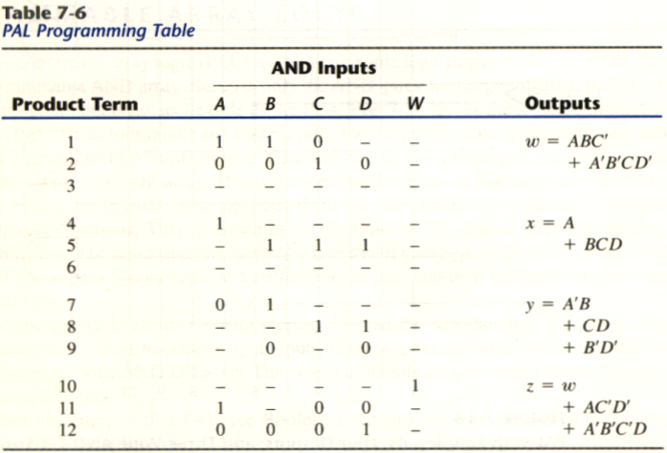
PAL Table
z has four product terms, and we can replace by w with two product terms, this will reduce the number of terms for z from four to three.

Slide 52
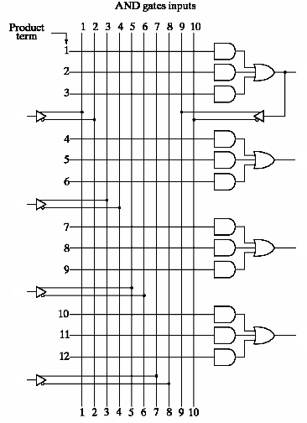
PAL implementation
w
A
x
B
y
C
z
D

Slide 53
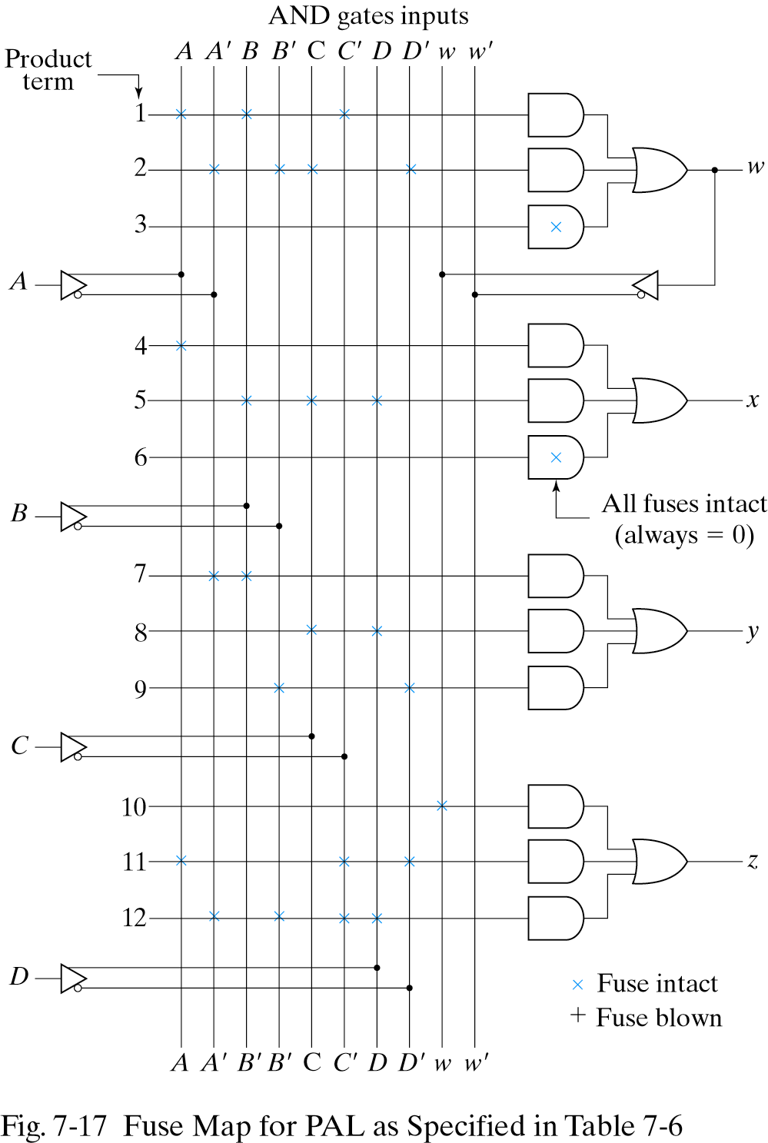
Fuse map for example

